Slide 1


AustiansRisk.com
Austian's Risk Services, Inc., (ARS) specializes in the development and management of safety and regulatory review processes as well as risk assessment and advisor services, expert witness services and underwriting risk analysis.
The Developers of
ARSRiskReductionReviews.com
August 2015

Slide 2
Mission
Austian's Risk Services, Inc. (ARS), primary mission is to assist companies in the prevention of accidents, controlling accident related costs and regulatory compliance. ARS strives to exceed each client's needs to ensure maximum results are achieved. Our goal is to be the premiere risk management service company in the USA and abroad.
ARS has helped many large companies turn their safety program around thus saving countless lives, injuries, property damage and millions of dollars.

Slide 3
History
Privately owned Oklahoma based company incorporated in 1990. We have celebrated our 26th year in business
Provides Risk Services for Both National and International Companies
Over 30 Years of Safety and Risk Management Experience
We have Conducted or Overseen Over 3,000 Safety Reviews
Owner has been an Expert Witness for Over 20 years
ARS Risk Reduction Reviews™ Developer has Over 30 Years of Software Application Development and Related IT Experience for Large Corporations and Commercial Software Development Companies.

Slide 4
Services
Risk Reduction Review Services
Strategic Risk Assessment and Safety Advisor Services
Underwriting Risk Analysis
Development and Management of Safety and Regulatory Review Processes
Risk Control Program Development
Risk Reduction Review Training
Risk and Safety Related Software Development for Desktop, Mobile, Web and Software as a Service (SaaS) Applications
Expert Witness Services and Catastrophic Claim Examination
Licensed All Lines Insurance Agent/Broker

Slide 5
Risk Reduction Reviews Drive Down the Risk of Doing Business
High Risk
High Risk of Doing Business
Low Risk

Slide 6
High Risk in Any Business Causes Vehicle and/or Injury Accidents that Cause
Fatalities
Pain and Suffering to Families
Financial Crisis to Families
Property Loss
Financial Loss to the Company and Employees
Massive Management Time Lost

Slide 7
Happy Families
Happy and Productive Employees
Financially Strong Company
High Company Image
Happy Management
ARS Risk Reduction Reviews Reduces Vehicle and Injury Accidents that in Turn Produce:
Low Risk / Higher Profit
2015 and to Infinity and Beyond!
High Risk / Low Profit
2014
2013
INCREASED PROFITS

Slide 8
Primary Goal
The Primary Goal of ARS Risk Reduction Reviews™ is to:
Identify the Problems Producing Loss or Exposure to Regulatory Issues and Suggest the Most Effective Remedy
Train Location Management How to Reduce and Eliminate as Much Risk to an Operation as Possible
Evaluate their Safety Performance
Provide them With Clear Direction on How to Keep Improving
Results In
  Reduction of Accidents
  Reduction of Negligent Risk Factors
  Reduction of Regulatory Violations

Slide 9
Maximizes Management’s
ARS Risk Reduction Reviews™ Maximizes Management’s:
Safety and Regulatory Training
Safety Performance to Your Standards of Performance
Focus on Opportunity Areas to Improve Safety and Regulatory Performance

Slide 10
Consistently Reduces
ARS Risk Reduction Reviews™ Consistently Reduces:
Accident Frequency
Negligent Accident Cases
Accident Costs
Regulation Compliance and Violation Issues

Slide 11
Utilized by
ARS Risk Reduction Reviews™ are Utilized by:
Risk Managers, Safety Directors and Other Senior Management of Client companies that for the Most Part are Self-Insured
For External Reviews
For Internal Reviews
For A Combination of Internal and External Reviews

Slide 12
What It Will Do for Your Staff
ARS Risk Reduction Reviews™ Will:
Keep Staff all on the Same “Page”
Improve Teamwork and Organization
Increase Professionalism and Expertise
Simplify Training and Shorten the Learning Curve
Help New Staff Members Get Up to Speed Faster
Provide a Better, More Standardized Career Path
Enable You to Maintain Detailed Records and Notes
Reduce the Inefficiency of Paper, Checklists and Spreadsheet Data Collection

Slide 13
Risk Reduction Reviews are:
ARS Risk Reduction Reviews™ are:
Tailored for Your Company
Automated for Quick Review Turnaround
Flexible. Enabling You to Use All or Selected Components
Supported With Applicable References to OSHA, DOT, EPA and ADA Regulations
A Tool for Measuring the Performance of Your Staff
Able to Preview/Print/Email Reports at the End of a Review
Undergoing Continuous Improvement and Feature Enhancement

Slide 14
A Third Generation Program
ARS Risk Reduction Reviews™ are:
Based on Over 30 Years of Safety Professional Experience
Generates a Corrective Action Plan With Best Practice Methods for Improvement
Flags Critical Parts of a Company’s Risk Components
Weights Opportunity Items as to How Important they are to Overall Risk
Expert Witness Type Review Process
Educates the Management Being Reviewed
Consists of 140+ Review Area Modules

Slide 15
Reports and Analysis
ARS Risk Reduction Reviews™ Reports and Analysis can:
Show Year to Year Changes by Segment and Prior Review Scores
Reports Can Show Comparison Scores With Established Standards of Performance
Reports Can be Printed or Emailed at the End of a Review and Used in the Closing Conference
Reports and DATA can be Sent via the Internet and Outlook
Show Built-In Analysis of Review Information
Reports and Analysis can be Customized or New Ones Developed for Your Company

Slide 16
Corrective Action Plans
ARS Risk Reduction Reviews™ Corrective Action Plans:
Covers Each Area Reviewed that Has an Opportunity Area for Improvement
Has a Defect Detail that Breaks Down Each Area for Full Understanding and a Suggested Action
Allows Location Management to Edit or Add to the Actions to Best Fit their Needs in Making the Improvement
Location Management Can State What Person Will be Doing the Actions, Set Target Dates for Completion and Date Completed for Each Action
It is critical that each action on the action plan be completed on a timely basis and documented in order to reduce the risk and to assure that the review findings cannot be used against the company in the future.

Slide 17
Review Areas
ARS Risk Reduction Reviews™ Major Review Areas:
6 Major Review Areas (Groups)
  Safety Program Implementation
  Substance Abuse Program
  Security Program
  DOT Program
  OSHA Program and Record Keeping
  EPA Risk Management Program
25 Segment Review Areas (Subgroups)
140+ Review Areas (Modules)

Slide 18
Are Used to
ARS Risk Reduction Reviews™ Are Used to:
Guide the Reviewer/Auditor Through the Review
Contain Critical Information to Conduct the Review Quickly and Efficiently
Collect All the Information Needed for Each Review and Stores the Information for Future Reference
Provide All the Reports and Analysis at the End of the Review to Use at the Closing Conference and to Send Out to the Management Teams
Track their Progress
Use the Results in their Periodic Performance Reviews

Slide 19
Conducted by
ARS Risk Reduction Reviews™ Are Conducted by:
Starting With an Opening Conference
Requiring Management Involvement
Reviewing Each Area as an Expert Witness Would
Repeatedly Reviewing Each Area
Selecting Information to be Reviewed at Random
Teaching Location Management How and Why
Conducting a Closing Conference
Providing the Management Team With Detailed Reports
Providing a Corrective Action Plan Template

Slide 20
95% Reductions
ARS Risk Reduction Reviews™ Will Reduce:
95% or More of a Reviewer’s Time in Developing Reports and Analyses
95% or More of a Location Management Team’s Time to Develop High Quality and Effective Corrective Action Plans
Traditionally, it Takes Reviewers the Same Amount of Time to Develop High Quality Reports as it Does to Conduct the Physical Review . Quality Action Plans are Rarely Developed by Location Management Due to the Many Hours it Takes to Develop One!
The Cost of Conducting High Quality Reviews is Almost Cut in Half and the Reports and Action Plans Will Always be of the Highest Quality.

Slide 21
Long Term Use of:
Long Term Use of ARS Risk Reduction Reviews™ Will:
Provide the Information Needed to Establish a Standards of Performance to Safety at Each Management Level
Target Management’s Efforts Towards What is Needed on a Daily Basis to Keep their Location’s Risk Levels Down
Help Your Company to be Number One in Safety in Your Industry, Operate More Efficiently and be More Profitable
Most Importantly, it Will Save Lives and Injuries that Devastate Families

Slide 22
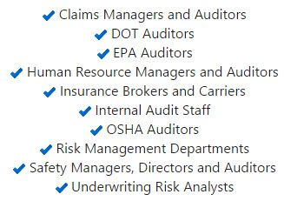
The Ideal Solution for these Jobs:

Slide 23
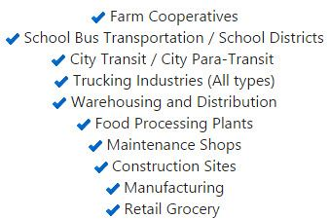
The Ideal Solution for these Industries:

Slide 24
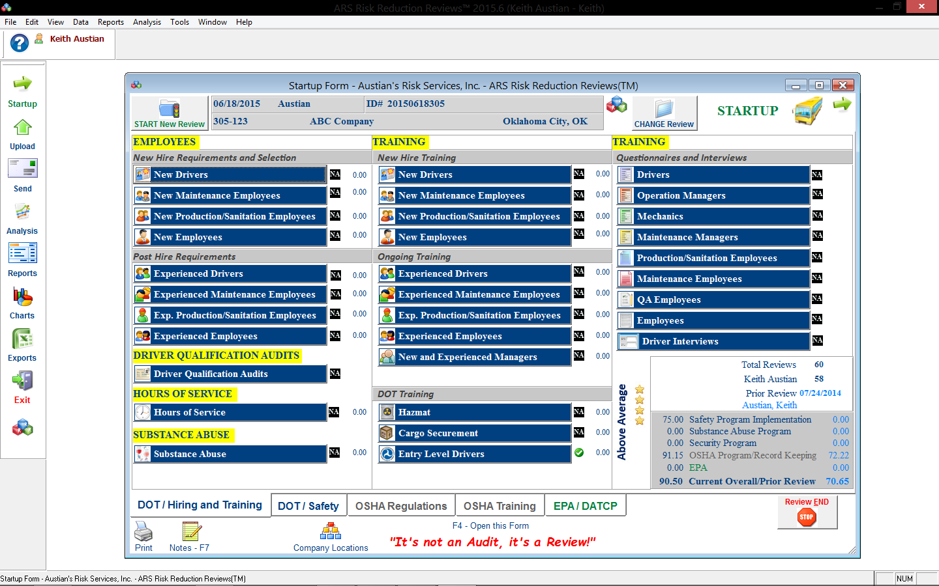

Slide 25
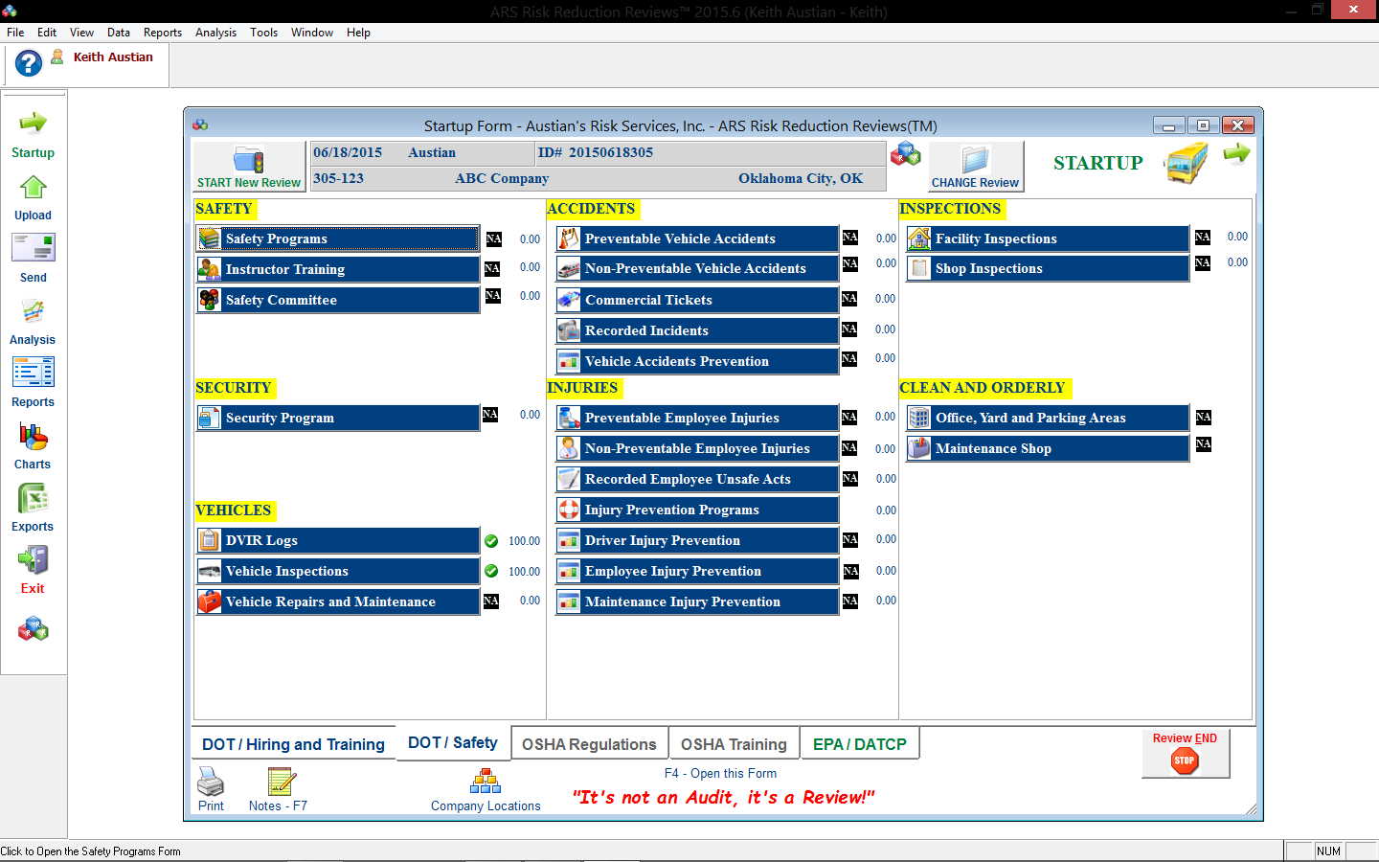

Slide 26
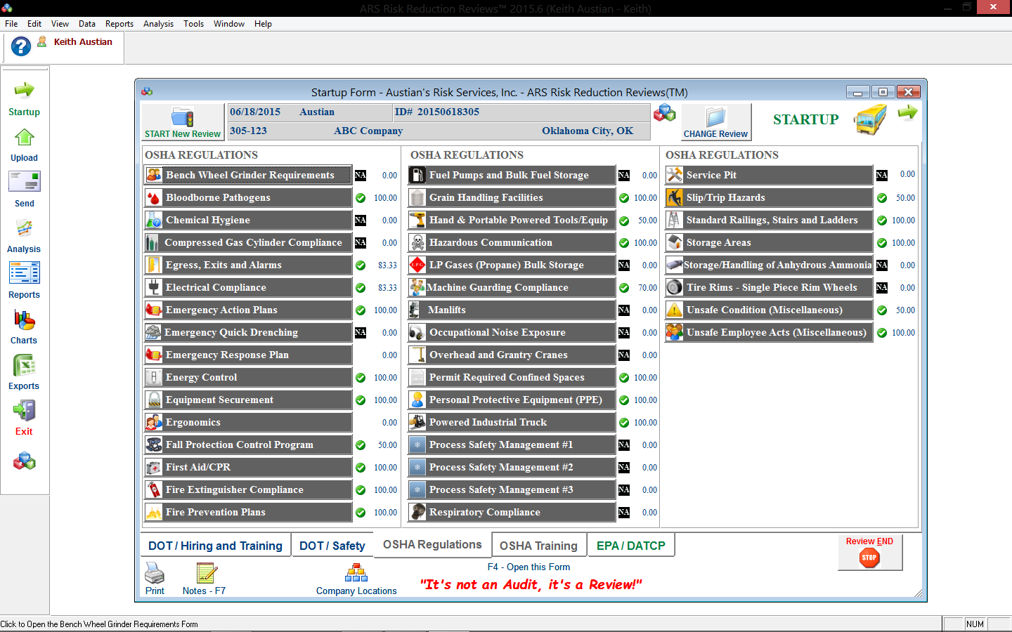

Slide 27
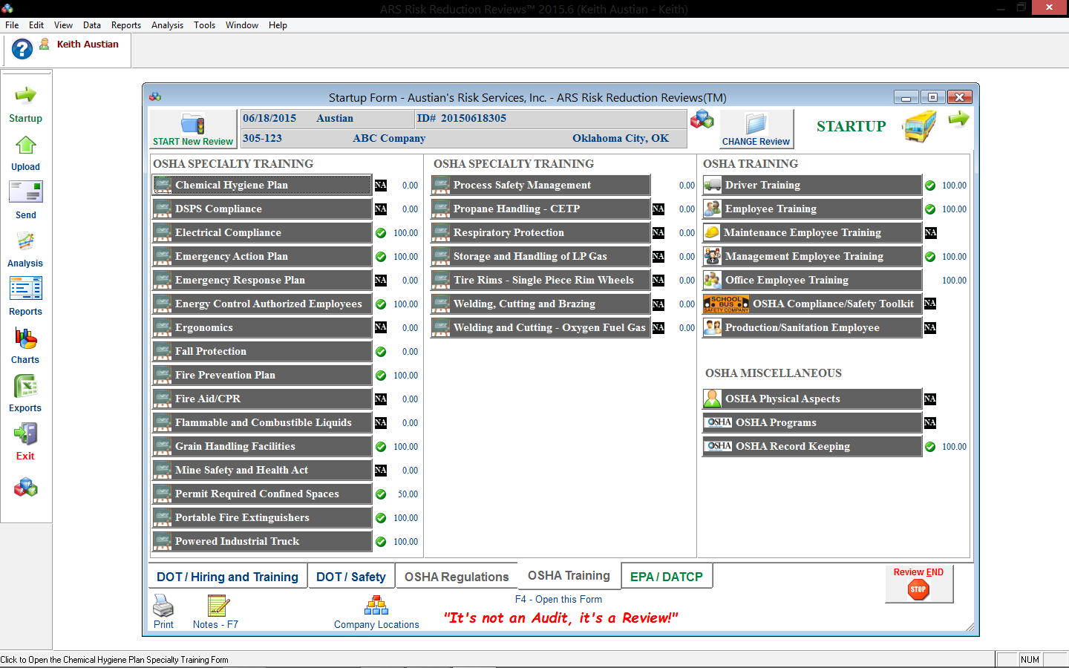

Slide 28
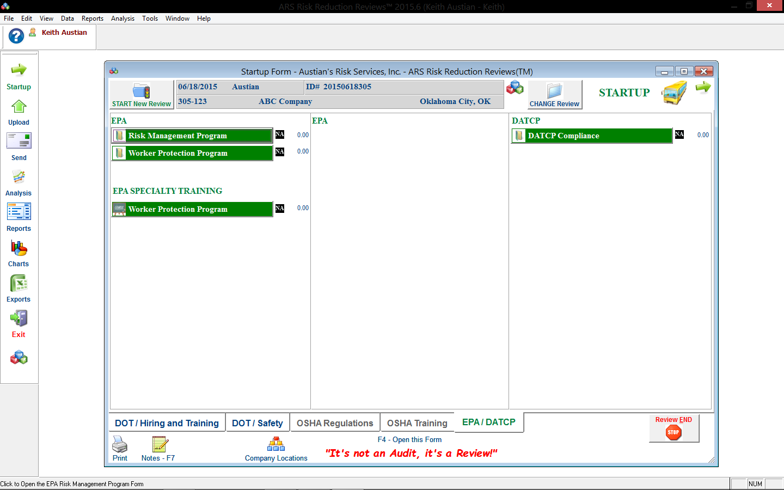

Slide 29

School Bus Safety Company
We are an Authorized Reseller of the Most Effective Student and Bus Driver Training Courses Available from the School Bus Safety Company
The School Bus Driver Training Course*
Safety Leadership Course
Transporting Students with Special Needs
Bullying Prevention on the School Bus
Safety Practices for Downed Power Lines
OSHA Compliance/Bus Garage Safety Toolkit
Children's Safety Programs
*The first ever National Association of Pupil Transportation (NAPT) Recommended Product

Slide 30

Transit and Paratransit Company
We are an Authorized Reseller of the Most Effective Bus Driver Training Courses Available for Drivers, Trainers and Managers from the Transit and Paratransit Company
Transit Operator Development Course
Paratransit Operator Development Course
Trainer Certification Process Course
Safety Leadership Course

Slide 31
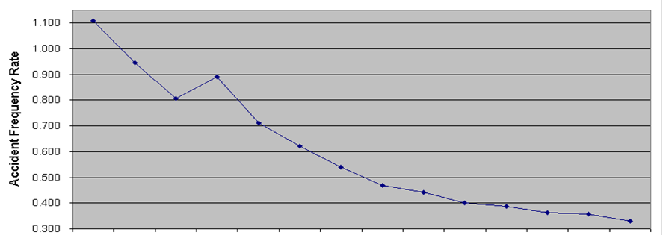
A Large Company’s Results:
Actual Results Using the 1st and 2nd Generation Program
1 2 3 4 5 6 7 8 9 10 11 12 13
Year

Slide 32

COO’s Executive Assistant
XYZ Company Moves to Number 1 in Safety
2013
2014
2015
2016
Austian's Risk Services, Inc. • Oklahoma City, OK • 405.799.8611 • AustiansRisk.com • ARSRiskReductionReviews.com

